Slide 1

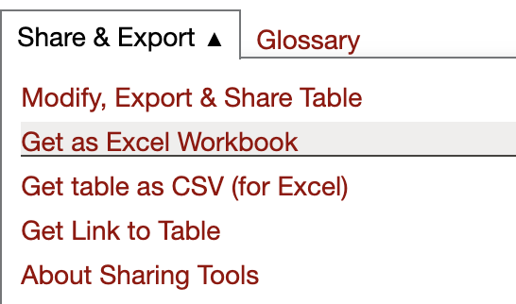
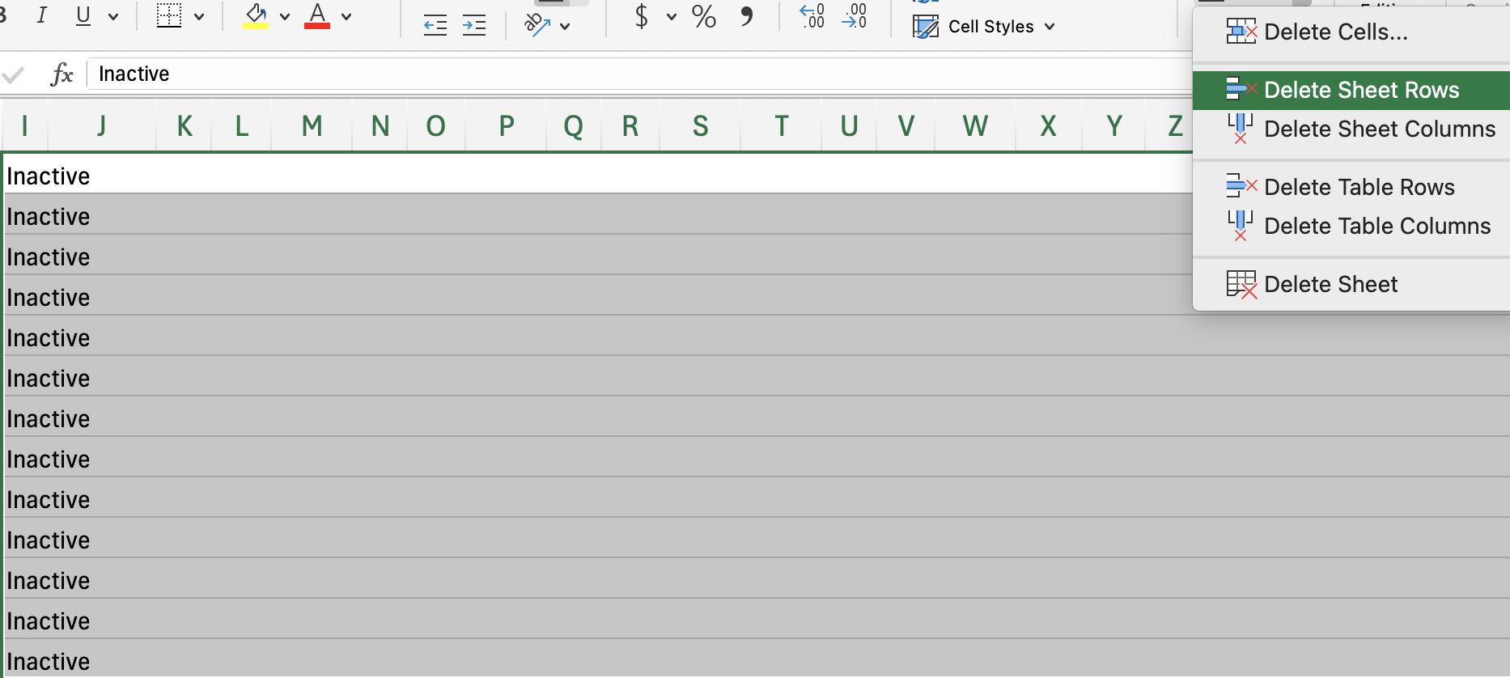
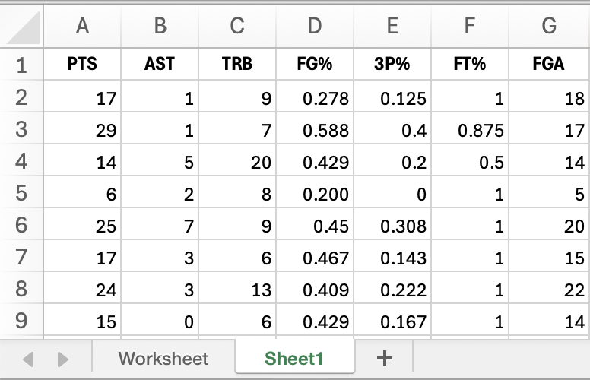
How to Analyze Data (Using Excel)
This is for general use for any sets of data requiring a basic understanding of Excel functionality and statistical analysis.
Step 1: Locate a Dataset
download the player's dataset
https://www.basketball-reference.com/search/.
Search for any player, choose the game log, and then pick any year.
Scroll down and find Share & Export above the regular season game log, then download it as an Excel workbook. See Figure 1
Figure 1
Step 2: Cleaning the Data
Open the downloaded workbook in Excel. Examine the data for rows that include ”Inactive” or “DNP.”
Then, delete the rows by highlighting them and selecting ”Delete Sheet Rows” in the top drop-down menu.
See figure 2
Figure 2
Step 3: Planning the Data
Before analysis, delete the final row with the average stats.
Make a new worksheet by clicking the “+” at the bottom left corner. Copy the PTS, AST, TRB, FG%, 3P%, FT%, and FGA columns into the new worksheet. To highlight the entire column quickly select the letter
See figure 3
Figure 3
Note:
During the data analysis process, define questions about what is interesting to explore, who this is for, and why should we analyze.

Slide 2
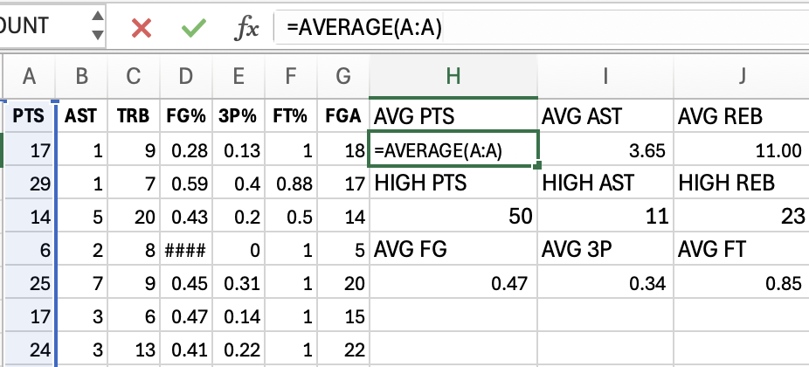
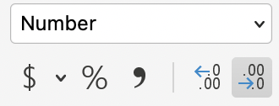
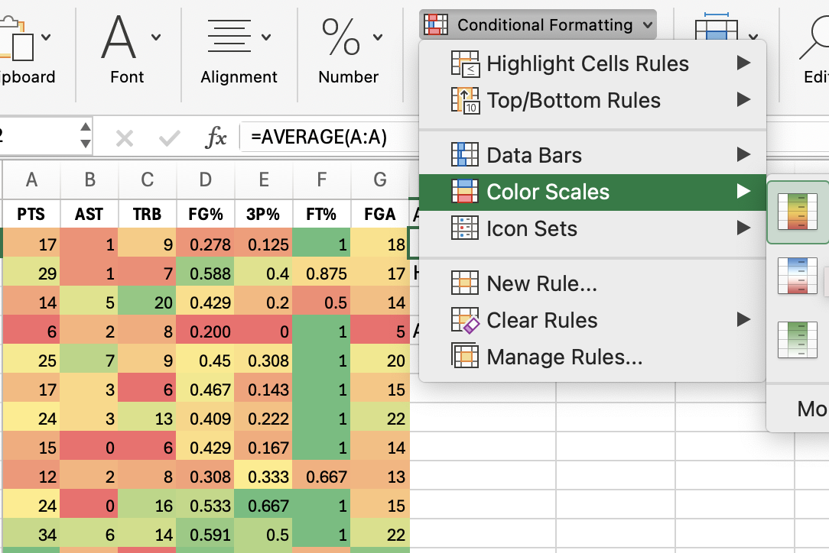
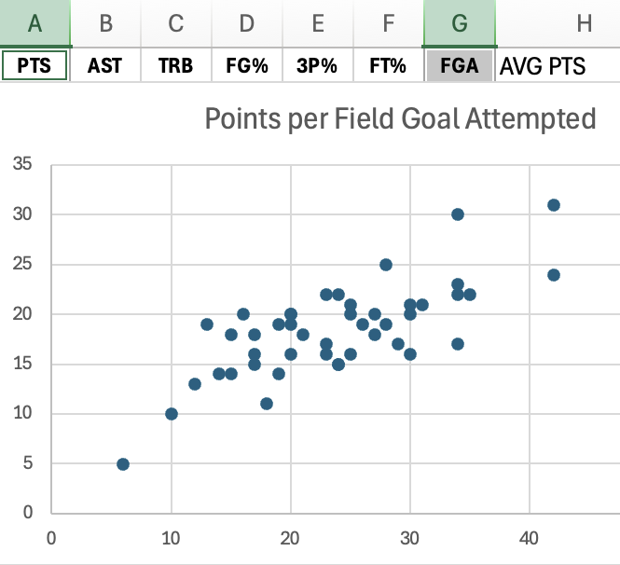
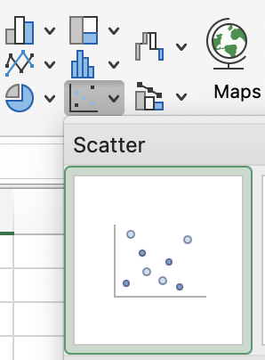
How to Analyze Data (Using Excel)
Step 4: Summary Statistics
Define new variables to calculate.
In a new cell, Using Excel functions =Average and =Max. select the whole column by clicking the letter above. See Figure 4.
Do this for each column and round to the second decimal point by changing the format from ”General” to “Number” in the menu above. See Figure 4
Figure 4
Step 5: Generate Heat Map
Highlight each column individually by clicking the letter, then choose ”Conditional Formatting.” Then, go to color scales and select the first option. See figure 5
Ask yourself what the colors represent, and would smaller or larger sets of data be better?
Figure 5
Step 6: Create Scatter Plot
To select non-adjacent rows, select the PTS column first by clicking the corresponding letter above then hold the ”command” key for Mac or the “ctrl” key for Windows, and select the FGA column.
Then go to Insert, select the scatterplot icon, and choose the first plot. See Figure 6
Select PTS
Hold Command
Select FGA
Figure 6
Step 7: Gather Insights
Ask yourself what insights can be made from the visualizations and statistics, and what questions would it help answer?
you have successfully analyzed the dataset using Excel

